Slide 1
Innovations in Inkjet for Packaging
12 March 2024
Notes:
“Innovations in Inkjet for Packaging” featuring Mary Schilling, Ralf Schlozer and Elizabeth Gooding will be live streamed on Tuesday March 12 at 1pm E.T.
The packaging market is growing and changing rapidly. Demands for greater sustainability, changes in customer buying habits and region specific regulatory requirements are all driving down individual batch sizes. While lithography and flexography continue to be the dominant printing processes for rigid and flexible packaging, inkjet printing is increasingly making inroads through the ability to version, personalize and deliver just-in-time orders.
Inkjet package printing technology is also becoming more interesting and accessible to a wider range of companies from commercial printing firms adding entry level package printing to their range of offers to large brands integrating packaging production into the product manufacturing process. Companies no longer need high volumes to get in the game, but packaging converters can find increasingly productive presses that raise the bar on quality and compatibility. What are the trends and innovations driving the market in 2024? Register to find out.
“Innovations in Inkjet for Packaging” will focus on key drivers of inkjet adoption and highlight that latest inkjet product launches serving the folding carton, corrugated, direct-to-container, and flexible packaging markets. Attendees will learn about:
Key areas of market growth for inkjet technology and capabilities needed to serve the market.
Considerations for different vertical markets such as food and beverage, pharmaceutical, and personal care.
New press launches and where they fit in the current market
This webinar will be useful to anyone investing in or developing production inkjet technology to deliver product packaging and with an interest in learning about inkjet component innovations that are likely to shape the market tomorrow.
Our expert panelists include Mary Schilling of Schilling Inkjet Consulting, Ralf Schlozer of digitalprintexpert.de and Elizabeth Gooding of Inkjet Insight on Tuesday March 12 at 1pm E.T. for a deep dive into the inkjet technology driving growth and flexibility in the packaging market.

Slide 2
Welcome
Let’s talk about packaging
Notes:
Housekeeping - Q&A not chat
Introduction to Ralf and Mary
Let’s talk about inkjet and packaging - there’s a lot!
Also companion shopping guides with more press coverage on the II knowledgebase

Slide 3
Interwoven consumer, regulatory & technology trends
Cost reduction
Rethinking e-commerce
Circularity
Sustainability
Interactive Package Design
Supply chain security
Notes:
Elizabeth
Several interwoven trends are driving changes to materials, processes and package design
Expanding e-commerce requires rethink
So much more is purchased online
Balance the “unboxing experience” (quality, color, branding, personalization) with showing eco-consciousness
Reducing shipping costs and eliminate excess packaging
But also design durably to manage returns and/or reuse - packaging design/materials
Sustainability
Environmentally friendly materials and processes
Materials that are thinner, reusable, recyclable or all three
Design Fit-to-product packaging and eliminate fillers
Print Direct to product - eliminating wraps and labels
Develop Awareness/tracking of complete supply chain for sustainability reporting
Seeking cost reduction/cost balancing
Sustainability requires investment in change
Seeking cost savings from less material
Lower shipping costs and Inventory optimization
Interactive Package Design
Enables simplified packaging design emphasizing form, function, cost, sustainability goals
Brings the ecommerce experience full circle - Extend the unboxing experience
Provides extended product information, demos and brand interactions in online or as AR experiences
Question: how to these trends force changes in the market and in press design?

Slide 4
Sustainability as driver in packaging technology
Government
Business
Consumer
Regulations on sustainability
Setting targets
EU deforestation regulation
EU Regulation on Packaging & Packaging Waste
US Extended producer responsibility (EPR) laws
Need to comply and honour consumer wishes
“Green image” perception
Avoid name & shame
Some are truly sustainability driven (Green in action)
Favour sustainability
Very vocal pressure groups
Lack detailed knowledge
Sentiments can change quickly
Notes:
Ralf
Packaging is affecting industries & businesses far beyond the print industry
Requirements will be driven by stake-holders outside of print
EPR laws are found worldwide, particularly in Europe and Canada, but are relatively new (and expanding) in the United States
latest EPR laws have focused on packaging materials, paper and plastic products, and food service service ware
7 States already have extensive EPR laws
11 Additional states have proposed pending EPR laws. The proposed law in NY includes a ban on carbon black
https://www.perkinscoie.com/en/news-insights/extended-producer-responsibility-packaging-laws-in-the-united-states.html

Slide 5
Sustainability Outlook
Recovery and recycling rates for packaging materials in the EU, 2019
Pending regulations
Active lobbying by multiple industry groups
Market confusion & Unintended consequences
Sustainability potential in all materials
Recycling rates / processes become critical
“Design for recycling and minimal impact”
Move to monomaterials
Reduce waste
Avoid spoilage
Be prepared to change processes quickly
Notes:
Ralf
Regulations are still in discussions
Active lobbying by multiple industry groups – creating confusion
Sometimes end-effects can be counterintuitive of working in contrary directions
Need to prepare for the unknown
All materials have their sustainability merit
Recycling rates & processes become critical
Move to monomaterials
“Design for recycling and minimal impact”

Slide 6
OEM Market Snapshot
Total OEM Revenue, HW, Supplies Service
CAGR 2022 to 2028
2022 starting value
Overall packaging grows with population.
Transition to digital is harder to measure.
Corrugated Post-print
Corrugated Pre-print - not measured!
Folding carton
Flexible packaging
Direct-to-container
Applications Dedicated Digital Presses
22%
Corrugated Single Pass Post Print
$138 m
15%
Flexible Packaging
$187 m
Source: IT Strategies
12%
Folding Carton
$70 m
Notes:
Elizabeth
Generally speaking - digital printing represents a tiny fraction of overall packaging production.
Growth of inkjet in these markets can be as simple as getting a small foothold as the overall market grows
But it has been difficult for inkjet to gain actual market share in many areas.
This packaging is notoriously difficult to estimate since there is a lot of cross over between segments and also
Because some types of presses are used for more than one thing.
Data from IT Strategies on the right tracks only revenue from presses dedicated to a particular application. Corrugated pre-print is not tracked.
Growth of each application starts from different base -
Folding carton 70 million in 2022
Flexible already at 187 million
Corrugated already at 138 million and exceeding 400 m by 2028
Ralf anything else you want to say about market segments and growth?

Slide 7
Substrate compatibility is the elephant in the box
Post Print
Uncoated: mottled, white top, bleached
Coated liners
Preprint
Coated liners
Flexible Packaging
PE, PP, PET, Paper, PVA, Cellophane, Metalized Films, PVC
Dimensional Printing
Glass, many plastics, several metals
Ranges from highly porous to completely sealed surfaces
Notes:
Mary
Post Print
Uncoated -mottled, white top and bleached
Coated liners – Metsa’s Kemi, Billerud
Preprint
Coated liners – Metsa’s Kemi, Billerud
Flexible Packaging
PE, PP, PET, Paper, PVA, Cellophane, Metalized Films, PVC
Dimensional Printing
Glass, plastics (many types) metal, aluminum, steel
EG note: How does push for thinner materials in some areas and stronger/more reusable materials in other segments create compatibility challenges or changes in press designs?

Slide 8
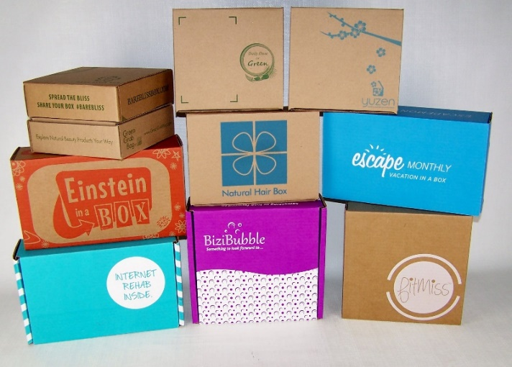
Considerations for Corrugated Post Print
Warp
Flute topography
Primer Application
Flute compatibility
Head height-throw distance
Print quality
Flat tints
Dot size / spread
Uniformity
Auto stackers
Palletizing
Wrapping and banding
Speed
Board & print width
Notes:
Mary
Overlap with display
Inspection systems
Warp detection
Automatic defect ejection

Slide 9
Range of OEMs and capability
Agfa (microflute only)
Barberán
Domino
EFI
Hanway
Kento
Konica Minolta
Koenig & Bauer Durst
RTZ FLORA
Xeikon
Widths: 1.3 to 2.5 meters
Speed: 27 to 150 meters/min
Resolution: 360 to 1200 dpi
Colors: 4 to 6
Inks: Aqueous, UV
Other: with/without primer, varnish, inspection systems, auto-feeders and stackers, defect ejection
See complete shopping guide
Notes:
Elizabeth - call out the many OEMs and models before highlighting 3 after
There are many players in this market - some with multiple presses
Many also cross-over to sign & display or can be configured for sign and display
Let’s look at a few presses showing the range of what is out there

Slide 10
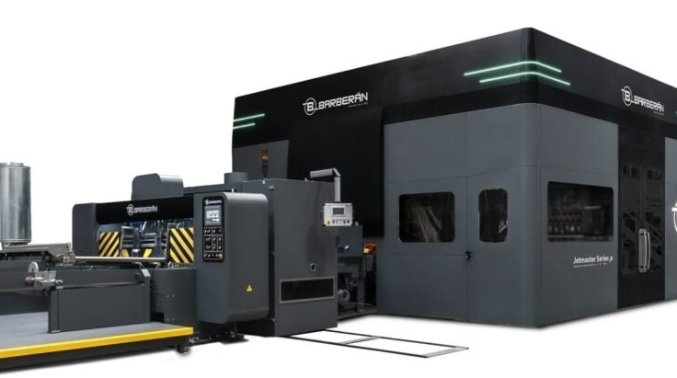
Barberán Jetmaster Series
Basis for Fujifilm HS6000 press for corrugated display
Series of presses
1260, 1750 &1890
UV Inks: CMYK + 2
Light Cyan & Light Magenta or
Orange & Violet
Print widths (mm):
1380, 1610 mm, and 1840
Speed 80 - 120 m/min
600 dpi
Self-calibrating inspection
Automated feed/stack
Fujifilm
Toyo
Sakata INX Kao Chimigraf
Open Ink Model
Notes:
Elizabeth
The Jetmaster series is not new - but has seen consistent upgrades and is also the foundation
for the newly released Fujifilm HS6000 press for corrugated display.
In addition to the highly configurable range of solutions that can be created in
terms of width, speed, colors and automation features the Jetmaster series is worthy of note for their ink model.
Other than the Kento Hybrid - baberan is the only OEM offering an open ink model
Barberán Jetmaster
(multiple configurations)
Epson printheads - piezo with 3 drop sizes
self-calibrating inspection system
UV CMYK plus 2
(Light Cyan & Light Magenta or Orange & Violet)
80 or 120 m/min
600 dpi
1380 mm
1610 mm
1840 mm

Slide 11
RTZ FLORA Rhino 2500 (Shenzhen Runtianzhi Digital Equipment Co.)
Newest in the Flora line
Auto feeder
Optional stacking system
Aqueous CMYK
2500 mm wide max
Epson S3200 printheads
90 m/min at 450 x 600dpi
60 m/min at 600 x 600dpi
45 m/min at 900 x 600dpi
30 m/min at 1200 x 600dp
Launched July 2023
APAC region focused
Notes:
Elizabeth
FLORA
Rhino 2500
Aqueous
CMYK
Epson heads with 4 gray levels
90 m/min at 450 x 600dpi
60 m/min at 600 x 600dpi
45 m/min at 900 x 600dpi
30 m/min at 1200 x 600dp
2500 mm
Flora also has a faster, higher resolution SPC2500 pro running at 150 m/min and up to 1200 dpi at lower speed

Slide 12
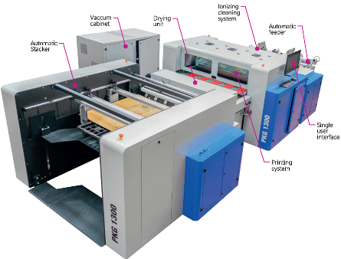
Konica Minolta PKG-1300
Entry level corrugated & carton
Automatic feeder and stacker
Aqueous pigment - CMYK
HP thermal printheads
27 m/min. at 300 x 1,200 dpi
18 m/min. at 600 x 1,200 dpi
9 m/min. at 1,200 x 1,200 dpi
1300 mm wide max
Launched Q4 2023
Notes:
Elizabeth
Based on the Multi 1300 from Mtex NS
Konica Minolta
PKG-1300
Aqueous pigment
CMYK
27 m/min. at 300 x 1,200 dpi
18 m/min. at 600 x 1,200 dpi
9 m/min. at 1,200 x 1,200 dpi
1300 mm

Slide 13
Consideration for Corrugated Preprint (Liners)
Primer
Ink uniformity
Multi-process “Campaigns”
Small runs
Speed
Heat of corrugator
Pin Holing
Ink adhesion
OPV
Notes:
Mary
What has changed
What matters now
What are barriers in this market

Slide 14
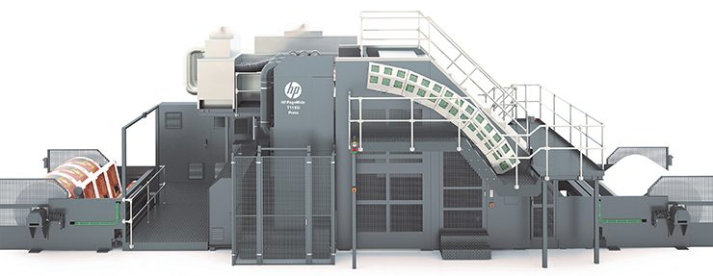
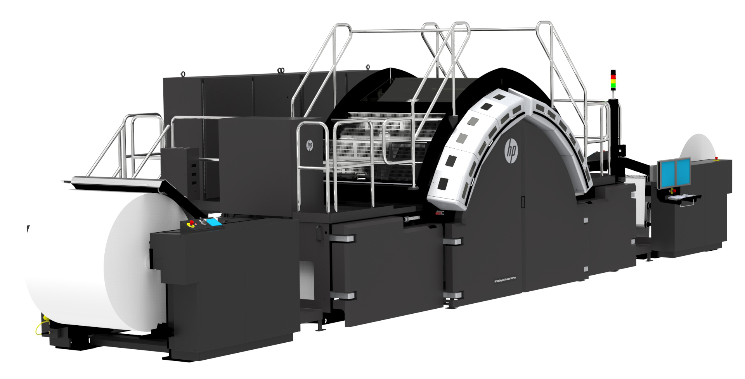
HP Dominates Corrugated Preprint
Both Presses
Six-color printing - CMYKOV
HP HDNA 1200 dpi
Priming Agent / Bonding Agent
HP T1100s series (w/ K&B)
up to 305 mpm /1000 fpm
Web width up to 2.8 m /110 in
HP Multi-lane Print Architecture (MLPA), runs jobs with varied box sizes and run lengths
P 400s series
183mpm / 600 fpm
web width up to 1.06 m /42 in and print frame-length up to 2.7 m / 108 in
Harris & Bruno inline coater (option)
HP PageWide T1195i
HP PageWide T470S
Notes:
Mary
Also mention HP T700i (cross over with folding carton)
Ralf note on BHS/Agfa promised solution?
Georgia pacific major customer (Hummingbird digital) has HP T1190, HP T400S and a T1100 110-inch press.
HP first preprint corrugated press PageWide T400S press, a 45-in. wide press prints at up to 600 fpm in mono and color with their HDNA imaging technology.
Also PageWide T1100S with a printing width of 110 in., now printing at up to 1000 fpm mono and color.
The HP T1100S was a partnership with Koenig & Bauer,
470s
print speeds up to 183 m (600 ft) per minute,
Support a wide range of applications with a web width up to 1.06 m (42 in)
Printable frame-length up to 2.7 m (108 in),
CMYKOV six-color offset quality with HP’s Thermal Inkjet (TIJ) heads
1,200 nozzles per inch and 8X nozzle redundancy.
coated, uncoated, and brown kraft packaging papers, with HP Priming Agent.
Harris & Bruno’s in-line coater for application of overprint varnish with knockouts with Aqueous and AQ/UV options
group job submission: print multiple jobs per roll for extreme productivity and minimal waste.
T1195i - faster, wider, more automation features. Integrates with large corrugators.

Slide 15
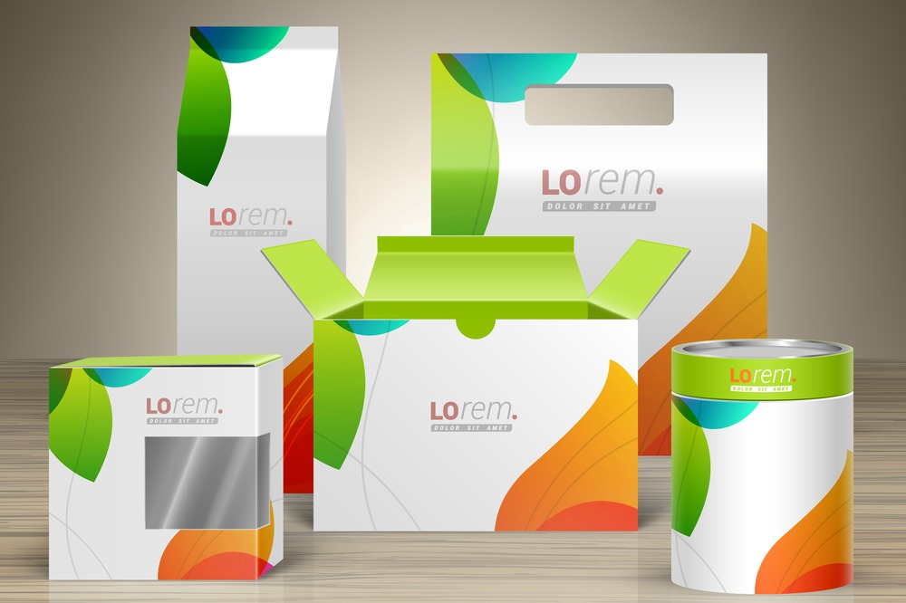
Considerations for Folding Carton
Primer
Speed
Ink adhesion
OPV
Food safety
Embellishments
Compatibility with postpress processes
Potential for crossover with corrugated post-print
Notes:
Mary
EG note: very wide range of adoption from tabletop units to integrated manufacturing
Often high color and print quality requirements - this is the main retail display packaging
See also Mark bale post on folding carton challenges
https://inkjetinsight.com/inkjet-knowledge-base/what-it-takes-to-print-folding-carton/

Slide 16
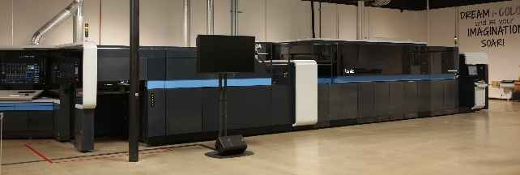
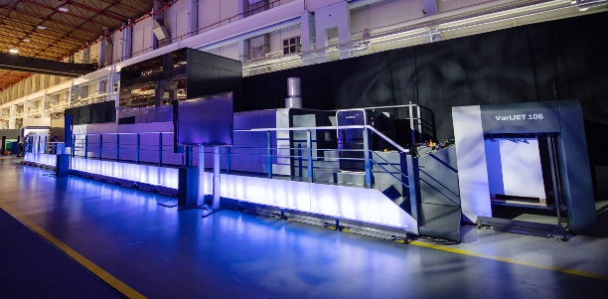
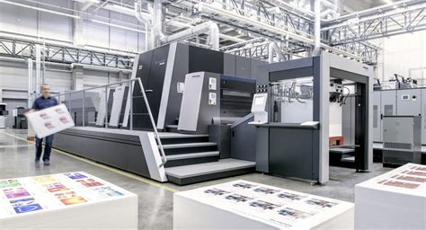
Folding carton presses – Dedicated Presses
Landa S10
Shipping since 2019
About 20 installs
Continuous improvements
Slow roll-out
High requirements in uptime, productivity, quality and substrate handling
Huge market potential but not as easy to address as expected
Koenig & Bauer Durst VariJET 106
2 beta sites in production
Heidelberg PrimeFire
Ditched due to cost-cutting measures
Too slow
Notes:
Ralf
Landa leading the market with about 20 installs
6500 sheets/hr (net productivity is lower however – Landa is working on this)
VariJET 106: Printing speed: 70 m/min – 5 500 sheets/h: Colours: 7C CMYK + Orange, Violet, Green
Primefire: 2,500 sheets/hr

Slide 17
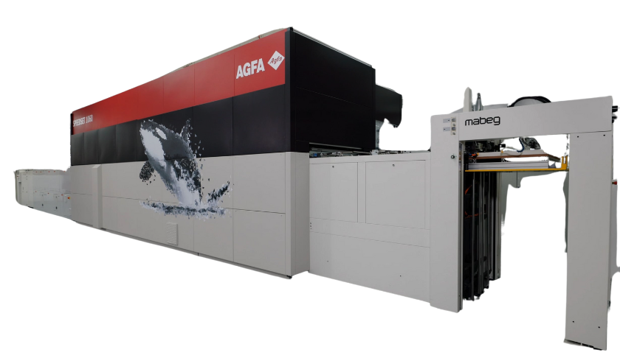
Agfa SpeedSet 1060
150 m/min at 800 x 1200 dpi
= 11,000 Sheets/hour
120 m/min at 1200 x 1200 dpi
Agfa Aqueous CMYK
Jetted Primer
Jetted Varnish
1060 mm wide max
Cross-over with corrugated post-print for microflute
Basis for further packaging press developments
First 2 beta sites in 2024
2025 early user availability
Launched December 2023
Notes:
Ralf
Agfa SpeedSet 1060
Agfa Aqueous CMYK
Primer
Jettable Varnish – 2 banks. Aqueous. For now mostly to protect. Other options possible
150 m/min at 800 x 1200 dpi – 11,000 sheets/hour
120 m/min at 1200 x 1200 dpi
1060 mm
0,2 to 2 mm substrate thickness – distance of heads adjustable
Microflute E & F only

Slide 18
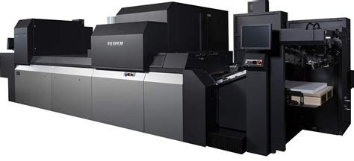
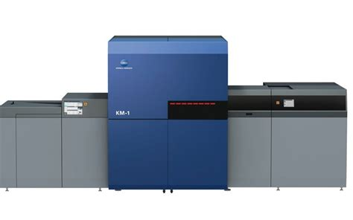
Folding carton presses – Commercial Overlap
Pros
Lower invest
Economy of scale in presses & inks
Application flexibility
Allows commercial shops to move into packaging
Better suited than SRA3 toner
Cons
Smaller format (B2+)
Much lower productivity
Limits in substrate types & thickness
Lack of in-line varnish
4C only
Fujifilm
Konica Minolta
Ricoh
Notes:
Ralf
Mixed-use presses – all B2
Mainly targeted at commercial with an eye on packaging -> light carton suitable
Not for heavy duty users
https://inkjetinsight.com/inkjet-knowledge-base/inkjet-verpackung-inkjet-packaging-the-german-way/
Economies of scale. Fujifilm with 50 new Jet Press installations globally in FY 2021-22 – now likely more than 300 JetPress in field. Leading to soaring Jet Press ink sales, up in Europe by 140%

Slide 19
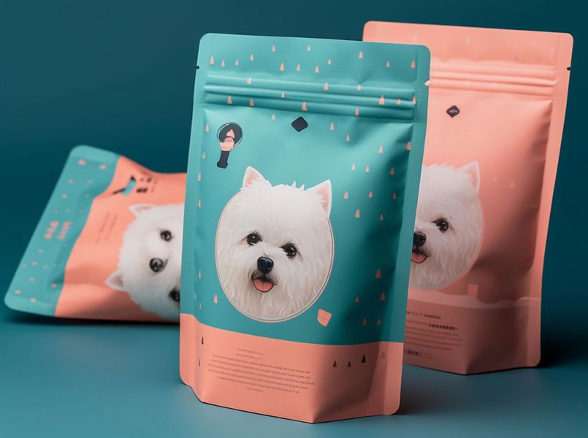
Considerations for Flexible Packaging
Static
Ink compatibility
Primer/pretreatment
Material stretch/slip
Barrier Coatings
Adhesives
Lamination Bond Strength
Direct/indirect food safe
Your Guide to Everything Flexible Packaging - Paramount Global
Inkjet Insight 2024 Flexible Packaging Inkjet Shopping Guide
Notes:
Mary
Note: handling reduced plastic waste
Food safe: UV failed outside of Japan. All are aqueous now

Slide 20
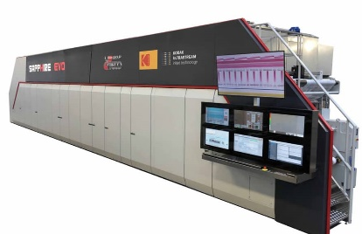
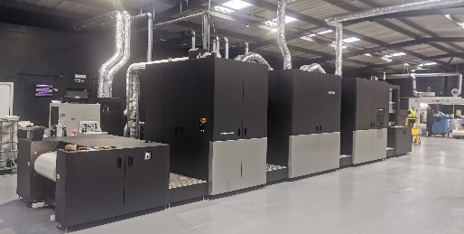
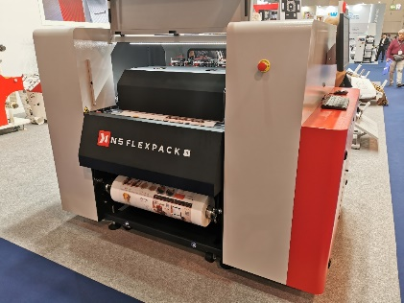
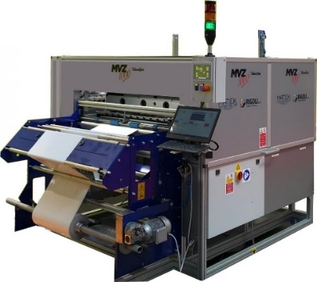
Market Tiers
High Volume Inkjet
For established producers
Multimillion $/€ investment
Moving shorter runs from flexo
Integrate w/ existing product flow
3-shift operations
Entry-Level
Start-ups – no flexo press owned
Low volumes
Limited range of materials
Competes with existing EP
Small vendors, limited market access
Notes:
Ralf
Recap existing presses, latest developments and introducing market tiers

Slide 21
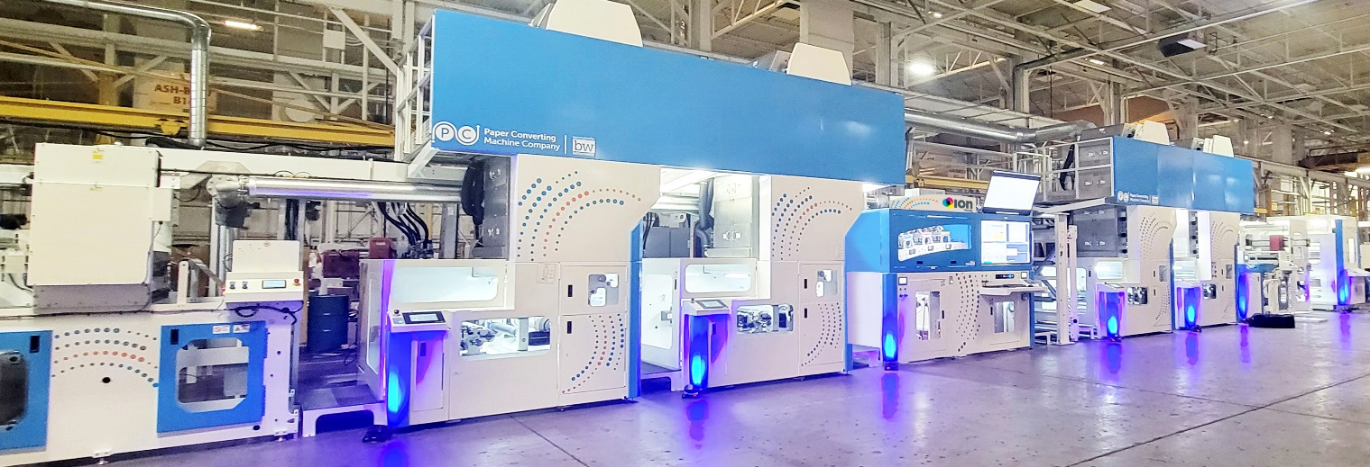
PCMC ION Flexo + Inkjet hybrid
Designed from the ground up as hybrid flexo-inkjet press
Up to 123 m/ min (400 fpm) in inkjet
CMYK inkjet – but flexo white possible
Memjet technology
Modular design
Multiple widths:
915 mm/ 36in
1066 mm / 42 in
1320 mm / 52 in
Notes:
Ralf -
Non stop unwind + rewind
4 flexo stations (2 before+2 + after)
ION CMYK
Turnbar + 2 flexo
In-Line Lamination
Defect detection
4C process Memjet printheads
Can also do folding carton

Slide 22
More flexpack vendors to come
(Landa, Comexi, ??)
Traditional flex pack producers cautious to invest
Innovation driven by start-ups
Insecurity in materials
Plastic under scrutiny
Monomaterials being trialed
Expect a slow ramp-up
Flexpack Outlook
Notes:
Ralf
Again big opportunities, but not that easy to address

Slide 23
Direct to Container Direct to Shape Direct to Product Dimensional Printing 4D Printing By any other name…
OEM Solutions
Custom Integration
Notes:
Elizabeth

Slide 24
Considerations for Dimensional Printing
Loading and Unloading
Changing dyne level of product
Ink compatibility
Ink curing
Adhesion/surface abrasion
Throw distance
Varied jetting angles up to 360º
Drop size
Specialty colors/effects
Specialized Transport
Notes:
Mary

Slide 25
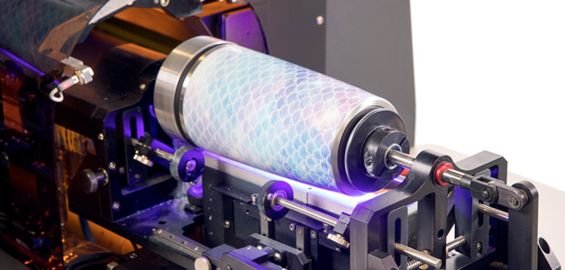
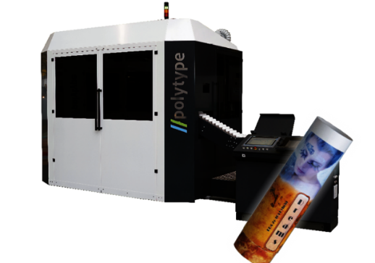
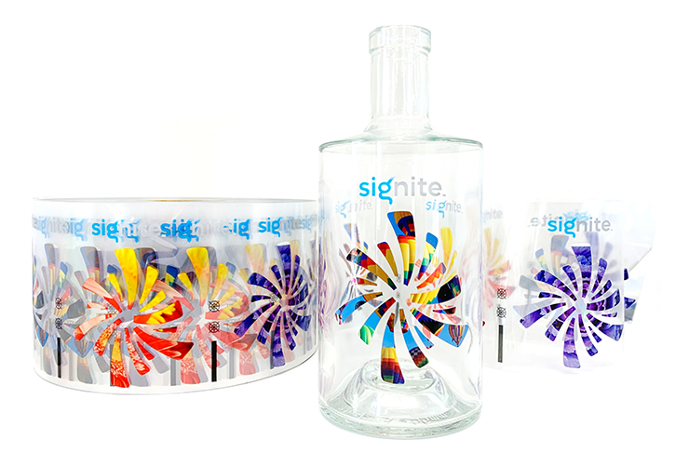
Minimum packaging
InkCups
Helix
Plastic serve ware
Polytype
Plastic containers
Hinterkopf
SLAC
Tonejet
Actega Signite
Notes:
Ralf

Slide 26
Questions? Elizabeth Gooding elizabeth@inkjetinsight.com Mary Schilling Mary@Schillinginkjetconsulting.com Ralf Schlozer ralf@digitalprintexpert.de Check InkjetInsight.com for the replay
Notes:
Which are the most cost sensitive markets?
What the remaining technical barriers to expand in low adoption markets?
Are there (motivated) barriers to inkjet adoption in certain segments?
What changes in finishing are impacting
What are some of the challenge with designing for digital production surfaces
Mention Package genie -

Slide 27
Upcoming Inkjet Insight Webinars
Spring Inkjet Update
drupa planning
Tuesday April 9, 2023
A look at 2024 Spring announcements and the inkjet technology to see at drupa 2024
Notes:
Spring Inkjet Update - drupa planning A look at 2024 Spring announcements and what inkjet technology to see at drupa 2024

Slide 28
Inkjet Insight provides valuable tools and resources to help companies objectively evaluate the potential of inkjet for their business, optimize their operations and grow their businesses using production inkjet.
Our Message to Printers, OEMs and the Industry at Large:
Evaluate. Optimize. Grow.
Repeat.

